Slide 1
Simplifying Firewall Rules with Network Programming and SRH Metadata draft-guichard-spring-srv6-simplified-firewall
_______________________________________________________________________
Presenter: James N Guichard. (Futurewei)
James N Guichard/Clarence Filsfils/Daniel Bernier/Zhenbin Li
Francois Clad/Pablo Camarillo/Ahmed AbdelSalam
IETF#105
________

Slide 2
Background
The IPv6 instantiation of Segment Routing, also known as SRv6, leverages the Segment Routing Header (SRH) defined in [I-D.ietf-6man-segment-routing-header] to encode a list of segments, as well as some complementary information in an IPv6 header.
Furthermore, [I-D.xuclad-spring-sr-service-programming] describes how segments can be associated with Service Functions and defines SRH TLVs specifically designed for carrying service metadata.
Together, these documents define an integrated solution for underlay, overlay and SFC that uses a single header and does not require any per-flow state in the network fabric.
In an SR domain, firewall policies are applied to control how the various endpoints, users or applications are allowed to communicate between each other.
These entities are categorized into classes for the purpose of applying policies to pools rather than individual entities.

Slide 3
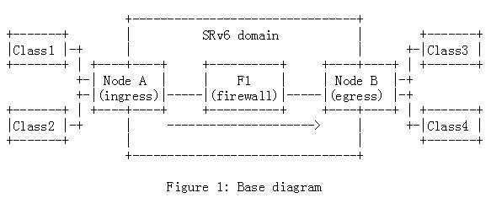
Use cases-Base diagram
Node A is configured to steer the traffic coming from Class1 or Class2 and headed to Class3 or Class4 into an SRv6 service policy to Node B, via the firewall F1.
Node A identifies the source and destination classes, encapsulates the traffic and attaches an SRH that contains the SR Policy SID-list, as well as the class information in the SRH TLVs.
The firewall F1 reads the SRH TLVs and decides to forward or drop the traffic based on the combination of the source and destination classes.
The availability of class metadata allows the firewall rule-set size to scale with the number of valid (source class, destination class) pairs. This drastically simplifies the firewall configuration and operation compared to a traditional 5-tuple-based model with tens of thousands of entries.

Slide 4
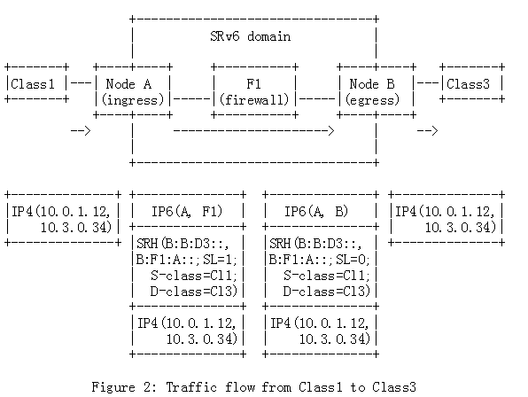
Use cases-1
A traffic flow from Class1 to Class3 is steered into the SRv6 Policy "<B:F1:A::, B:B:D3::>", where "B:F1:A::" represents a service SID instantiated on the firewall F1 and "B:B:D3::" is an End.DX4 SID on the egress node B that sends the inner packet to Class3.
The SRH "S-class" and "D-class" TLVs respectively represent the source and destination class identifiers. This traffic flow is allowed to traverse the firewall and reaches its final destination in Class3.

Slide 5
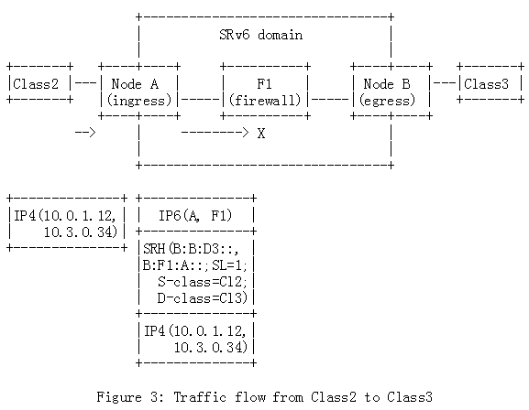
Use cases-2
In Figure 3, a traffic flow from Class2 to Class3 is steered into the exact same SRv6 Policy "<B:F1:A::, B:B:D3::>".
The SRH "S-class" and "D-class" TLVs are similarly populated with the source and destination class identifiers.
However, "S-class=Cl2" and "D-class=Cl3" does not match an authorized class combination on the firewall. The traffic is considered as invalid and dropped at F1.

Slide 6
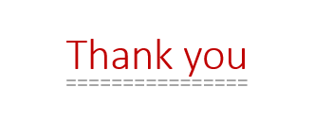
Next Step
A working demo is available, using FD.io VPP [FDio] instances as ingress and egress routers and the iptables-based SERA firewall [SERA].
Comments are welcome!

